Slide 1
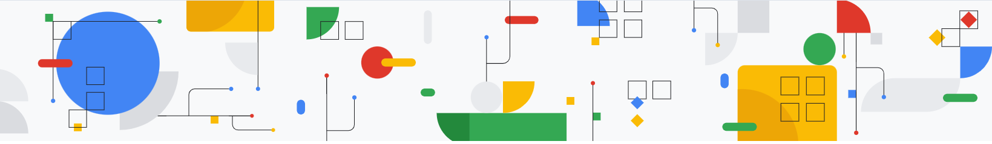
Langchain
:- Harsh Dalal

Slide 2
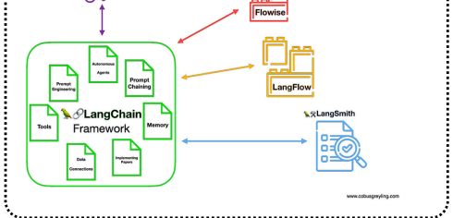
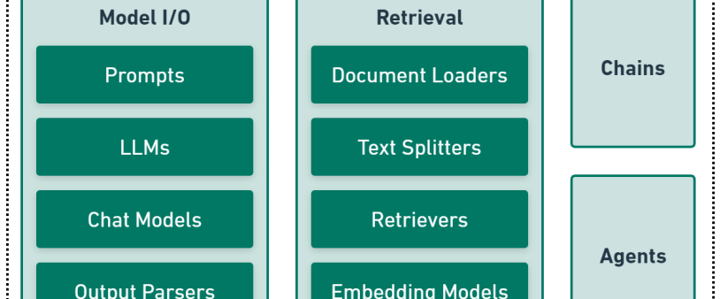
Deep Dive into Langchain

Slide 3

What is LangChain?
LangChain is an open-source framework for building applications powered by Large Language Models (LLMs). Available in Python and JavaScript, it offers tools and a unified environment to easily develop LLM-based solutions like chatbots and virtual agents.
Key features:
Acts as a universal interface for different LLMs.
Modular design allows easy swapping of prompts or models without major code changes.
Helps developers quickly build, test, and optimize LLM applications.

Slide 4
What is LangChain?
This flexibility also enables building programs that utilize multiple LLMs together, such as one model for interpreting user queries and another for generating responses.
The way I see it, LangChain is filling an important gap – providing a common framework to build upon, so that innovators and creators don’t have to reinvent the wheel every time they want to leverage the power of LLM.

Slide 5
How Does LangChain Work?
LLMs
LangChain enables seamless integration with LLMs from providers like OpenAI, Anthropic, and Google through a standardized interface, simplifying interactions by hiding the complexities of different APIs and data formats.
Chains
Chains in LangChain are sequences of LLM-powered steps that form complex workflows. They let developers connect multiple operations—like extracting data and generating responses—enabling more advanced natural language processing tasks.

Slide 6
How Does LangChain Work?
Agents
Agents are advanced LangChain components that build on Chains to handle complex, goal-driven tasks autonomously. They manage logic, memory, and workflows, enabling the creation of intelligent, context-aware LLM-powered actors.
Memory
LangChain's memory system enables LLMs to retain and recall information across multi-step workflows, ensuring context awareness and statefulness—crucial for building conversational and interactive applications.

Slide 7
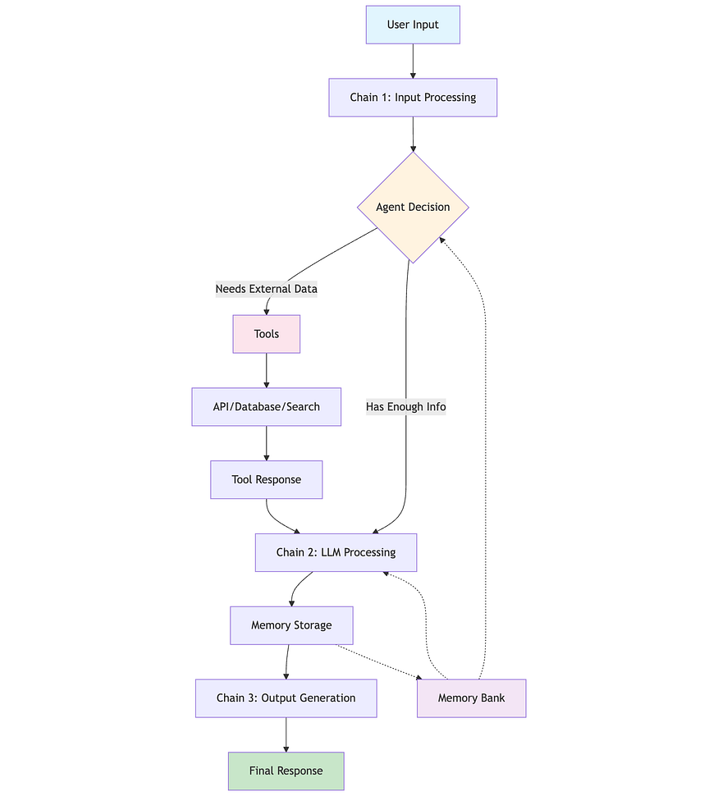
langchain workflow

